Slide 1


Slide 2
Why ?
Competition objective: Demonstrating the utilization of GPT to solve business challenges effectively.
Overcoming privacy concerns in interim and the need to safeguard confidential documents
Building standalone, network-isolated, self-contained instances of LLM with practical capabilities
Establishing internal GPT infrastructure to expedite adoption within the firm
Fine-tuning LLMs for specific tasks to achieve higher accuracy

Slide 3
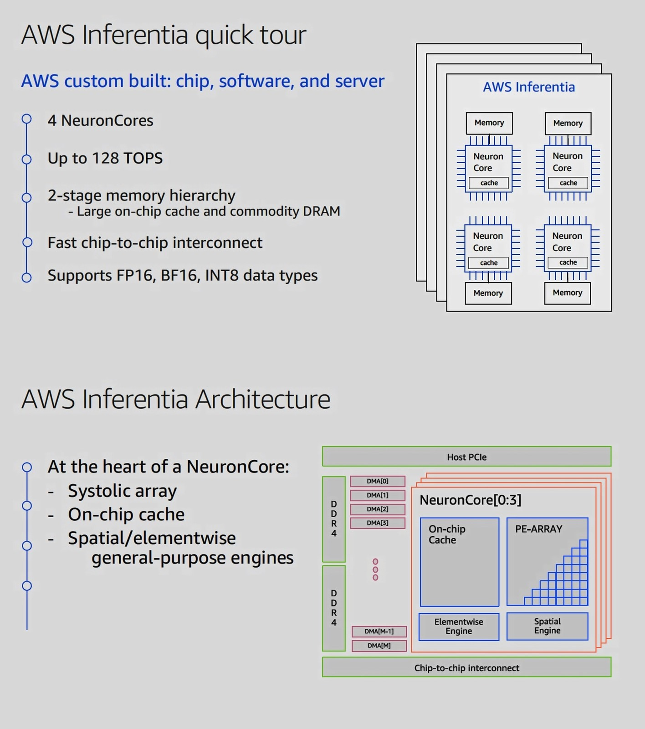
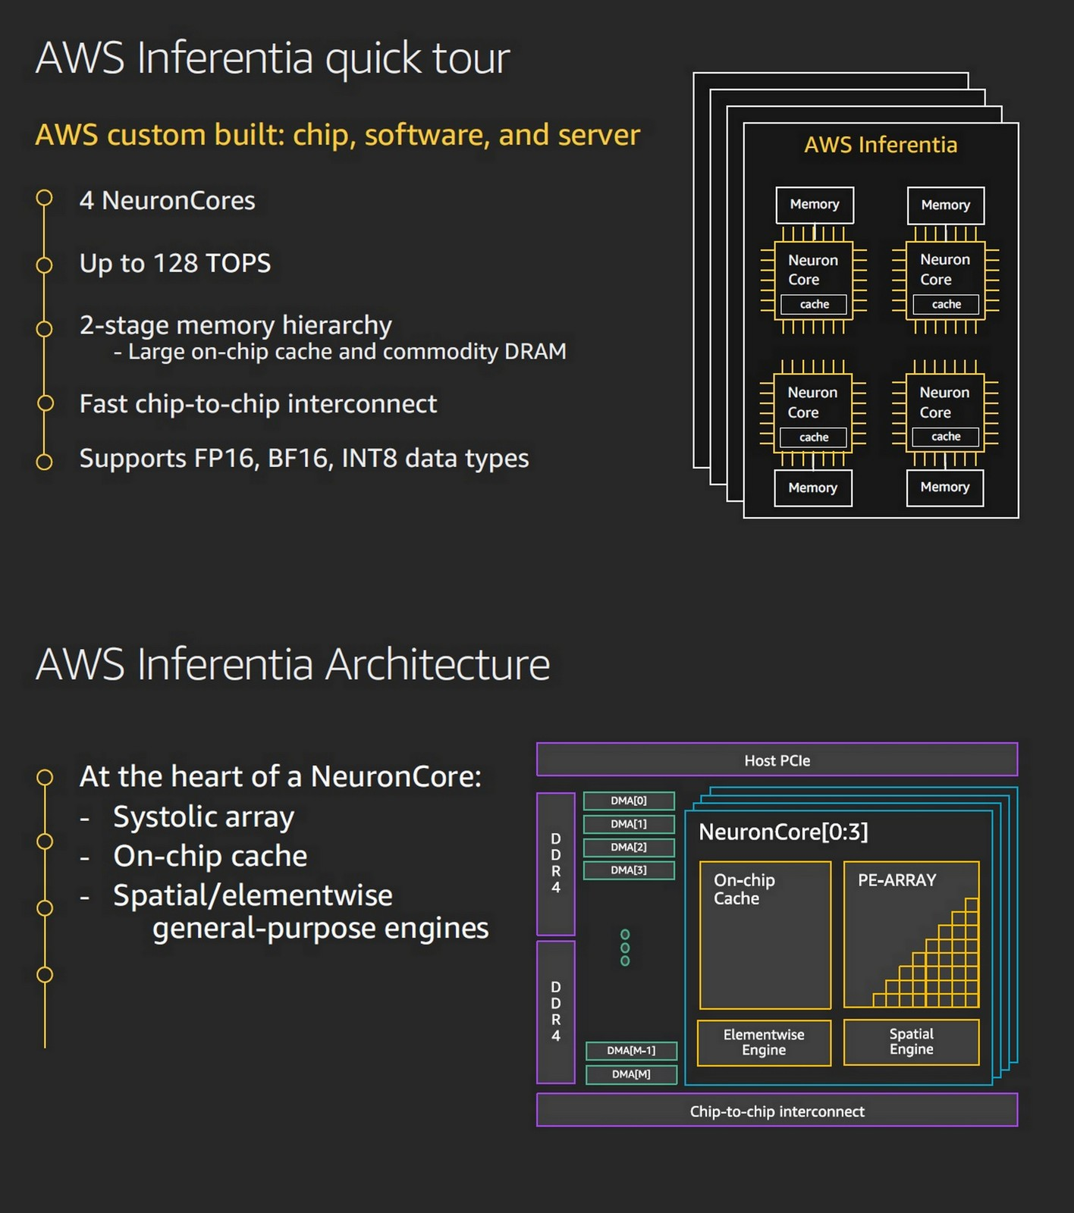

Slide 4
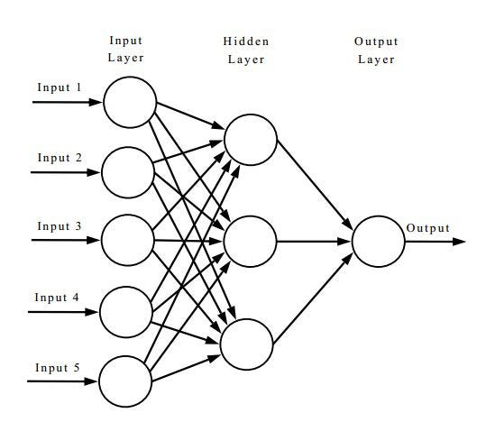
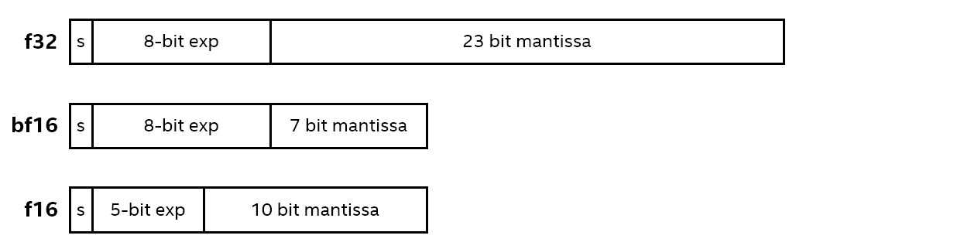
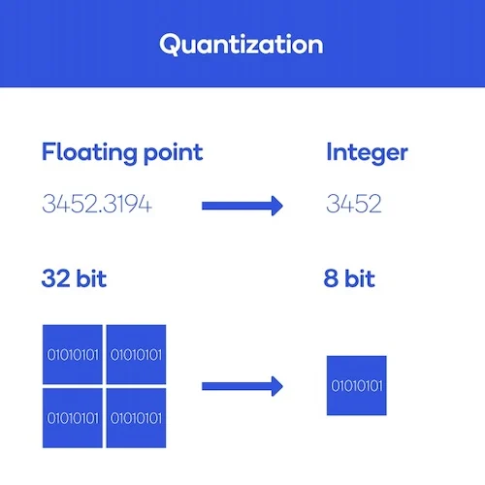
How we make it work ?
069.3659871251
236.0023536265
986.3257962535
069.3659
236.0023
986.32579

Slide 5
GPT LLM for Document Data extraction
What have we built Description in 1 paragraph

Slide 6
Why ?
Objective: Demonstrating the utilization of GPT to solve business challenges effectively.
Overcoming privacy concerns in interim and the need to safeguard confidential documents
Building standalone, network-isolated, self-contained instances of LLM with practical capabilities
Establishing internal GPT infrastructure to expedite adoption within the firm
Fine-tuning LLMs for specific tasks to achieve higher accuracy

Slide 7
How we make it work ?
069.3659871251
236.0023536265
986.3257962535
069.3659
236.0023
986.32579

